Slide 1
Operating Systems
RAFI ULLAH
Senior Data Scientist
Blutech, Jaffer Brothers
And
Adjunt Faculty PAF-KIET
Email: rafiafridi783@gmail.com
Github: github.com/rafi-afridi

Slide 2
Course Objective
To understand what a process is and how processes are synchronized and scheduled. Students should be able to use system calls for managing processes, memory and the file system. Students should understand the data structures and algorithms used to implement an OS.
Learn Linux Operating System, And implementation of different Linux concepts in C programing language

Slide 3
Different Concepts
Computer System Overview
Operating System Overview
Processes Concepts and Management
Threads and Multi-processing
Process Synchronizations and Deadlock
CPU Scheduling
Memory Management (Main Memory)
If we had time;
File Management
IO Management
Security and Protection

Slide 4
Prerequisite for OS
C and C++ Programming Language
IF Structure, Loops, Data types and Pointers
Book = Head First C-Programing Language
Data Structure
Array, Linked list, Stack, Queue, Heap
Book = Any best book
Audience = Students of BSCS or MCS program

Slide 5
Today’s Agenda
What is an Operating System?
What is Computer System?
Serial Processing
Batch Operating Systems
Multi-programmed Systems
Real -Time Systems

Slide 6
What is an Operating System?
OS as User Interface
A program that acts as an intermediary between a user of a computer and the computer hardware.
Operating system goals:
Execute user programs and make solving user problems easier.
Make the computer system convenient to use.
Use the computer hardware in an efficient manner.
OS as Resource Manager
(IO, Processes, Memory, Files etc)

Slide 7
Operating System Definitions
Resource allocator – manages and allocates resources.
Control program – controls the execution of user programs and operations of I/O devices .
Kernel – the one program running at all times (all else being application programs).

Slide 8
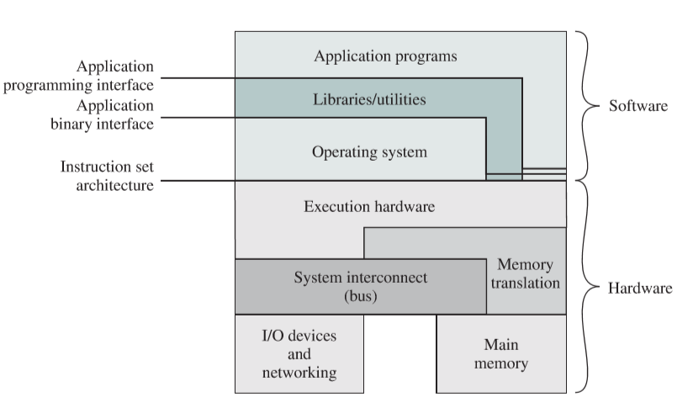
What is an Operating System?

Slide 9
Computer System Components
1. Hardware – provides basic computing resources (CPU, memory, I/O devices).
2. Operating system – controls and coordinates the use of the hardware among the various application programs for the various users.
3. Applications programs – define the ways in which the system resources are used to solve the computing problems of the users (compilers, database systems, video games, business programs).
4. Users (people, machines, other computers).

Slide 10
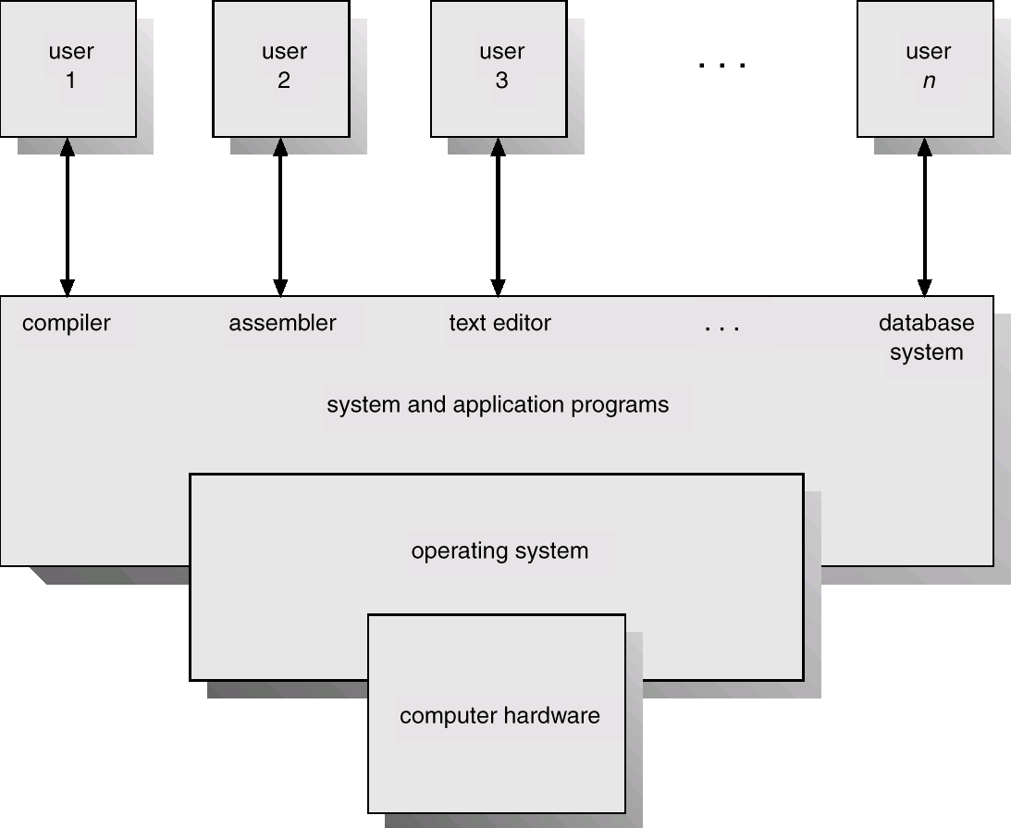
Abstract View of System Components

Slide 11
Serial Processing
Programs Loaded via input devices Tape, Card Readers
Output devices printers, lights etc.
Customer compilers and Interpreters
Two Problems
Scheduling – Program may take less time than committed or may take greater
Setup Time – Every one follow same process for loading their programs,
Solution – Load more programs, and common programs once for all users program

Slide 12
Batch Processing
Idea - Load more programs, and common programs once for all users program
Common libraries should always be there - Monitor
Problems:
Programs May affect each other
Dual Mode Requirements – Kernel and User
Requirements
Timer – avoid monopoly in case of stuck
Protection by hardware
Interrupts
Privileged instructions
Problem
Processor Idle most of the time as processor is very fast and IO devices are slow

Slide 13
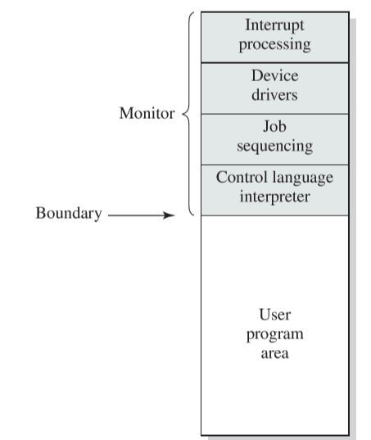
Memory Layout for a Simple Batch System

Slide 14
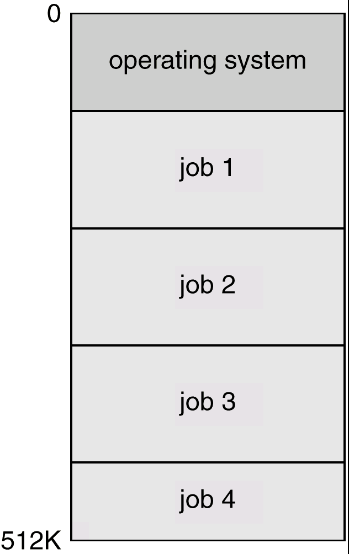
Multiprogrammed Batch Systems
Several jobs are kept in main memory at the same time, and the CPU is multiplexed among them.
To maximize processor utilization
Context Switching – From one program to another
Also known as multi-tasking
Memory management was the requirements
Programs Scheduling requirements
IO devices Management
IO operation was using
1 – IO driven using IO Status register
2 – Interrupts Driven IO
3 – DMA – Direct Memory Access

Slide 15
Time-Sharing Systems–Interactive Computing
The CPU is multiplexed among several jobs that are kept in memory and on disk (the CPU is allocated to a job only if the job is in memory).
A job swapped in and out of memory to the disk.
On-line communication between the user and the system is provided; when the operating system finishes the execution of one command, it seeks the next “control statement” from the user’s keyboard.
On-line system must be available for users to access data and code.

Slide 16
Real-Time Systems
Often used as a control device in a dedicated application such as controlling scientific experiments, medical imaging systems, industrial control systems, and some display systems.
Well-defined fixed-time constraints.
Real-Time systems may be either hard or soft real-time.
Air Traffic Control Systems, Networked Multimedia Systems, Command Control Systems etc.

Slide 17
Real-Time Systems (Cont.)
Hard real-time:
Secondary storage limited or absent, data stored in short term memory, or read-only memory (ROM)
Conflicts with time-sharing systems, not supported by general-purpose operating systems.
Soft real-time
Limited utility in industrial control of robotics
Useful in applications (multimedia, virtual reality) requiring advanced operating-system features.

